Slide 1

Forecasting Economic And Financial Time Series: ARIMA vs. LSTM
Teammates
Upamanyu Pathare
Yutao Shu
Yongsheng Liu
Hexin Xu
Bolun Deng

Slide 2
(Very) Quick Recap
In our previous analysis we noted that LSTM/ARIMA based models perform poorly.
Authors had misunderstood/overstated improvement arising from simple 1-dimensional LSTM models.
We explored more complex on shorter term data to evaluate it’s predictive power.

Slide 3
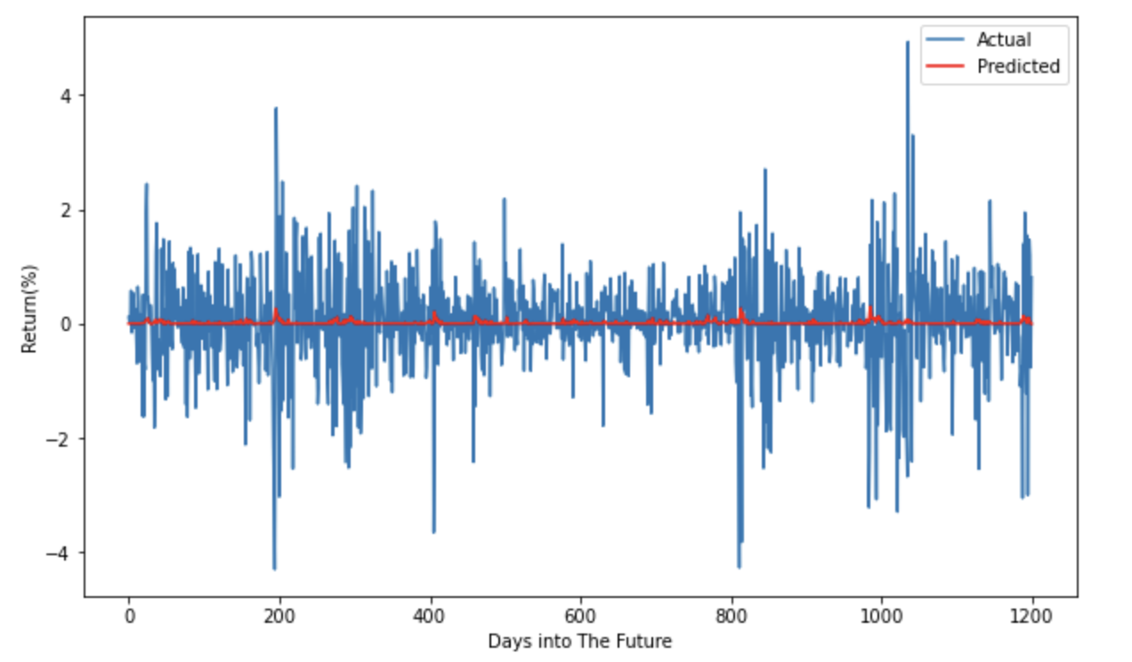
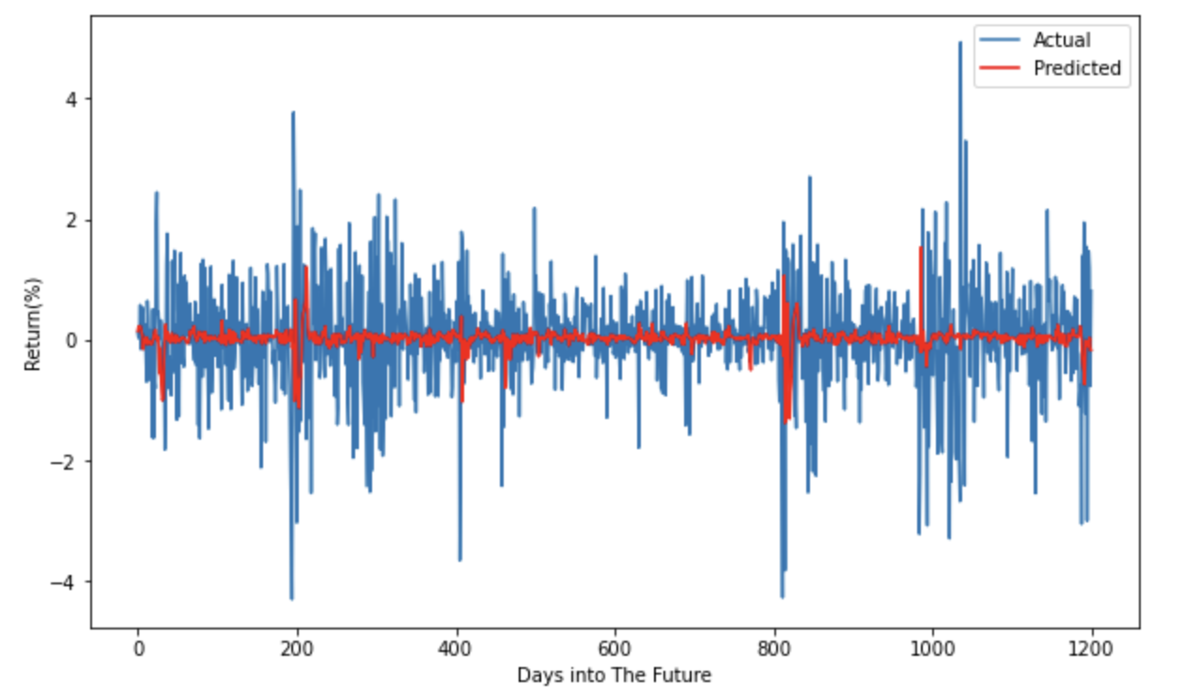
Last Week’s Results
Previous results: Both models fail to predict daily return
Target: Beat the null predictor
 | Null Predictor | Single LSTM | Double LSTM
MSE (%) | 0.7384 | 0.7392 | 0.7693
MAE (%) | 0.5886 | 0.5886 | 0.5996
 |  | Underfitting | Overfitting
Evaluation of LSTM Models on Daily S&P Data

Slide 4
Improvements
More data: 1-min frequency BTC/USD
Dataset: 1-min BTC data (2014-12-01 – 2019-01-09), Coinbase
Open, High, Low, Close, Volume
https://www.kaggle.com/mczielinski/bitcoin-historical-data
Feature Engineering
Construct 10-min features on 1-min data
Return, log(High / Low), log Volume / mean(Volume, 1day), etc
Input features are stationary across time

Slide 5
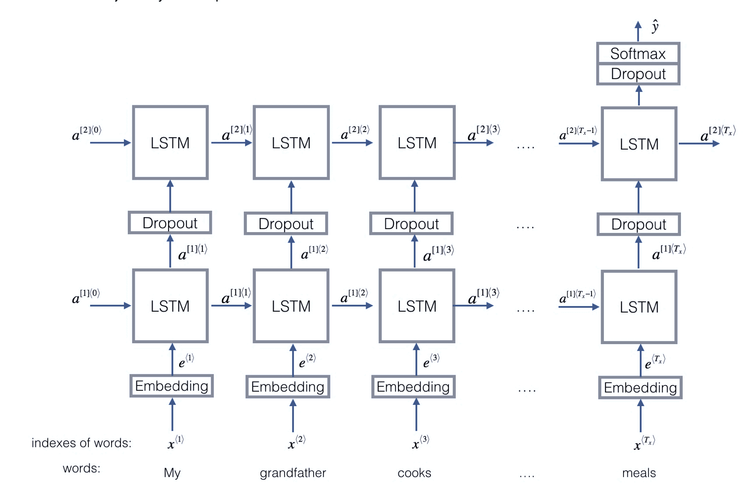
Basic Framework
Input: a time series of past 10-min features,
#sample, T=36 (6h), #feature=7
Output: prediction of the return in the next hour
Loss function: MAE
A double-LSTM framework on sensitive analysis. (Emojify, Coursera)

Slide 6
Feature Engineering
Features
Relative_vol | volume / past 1 days average 10min volume
Return | 10min log return
Relative_HML | log(high / low)
Rvol | sum(abs(return))
Return_ETH | 10min log return of ETH
Price_diff_1h | MACD: log(10min MA/ 1h MA)
Price_diff_12h | MACD: log(2h MA / 12h MA)
Input Features Summary

Slide 7
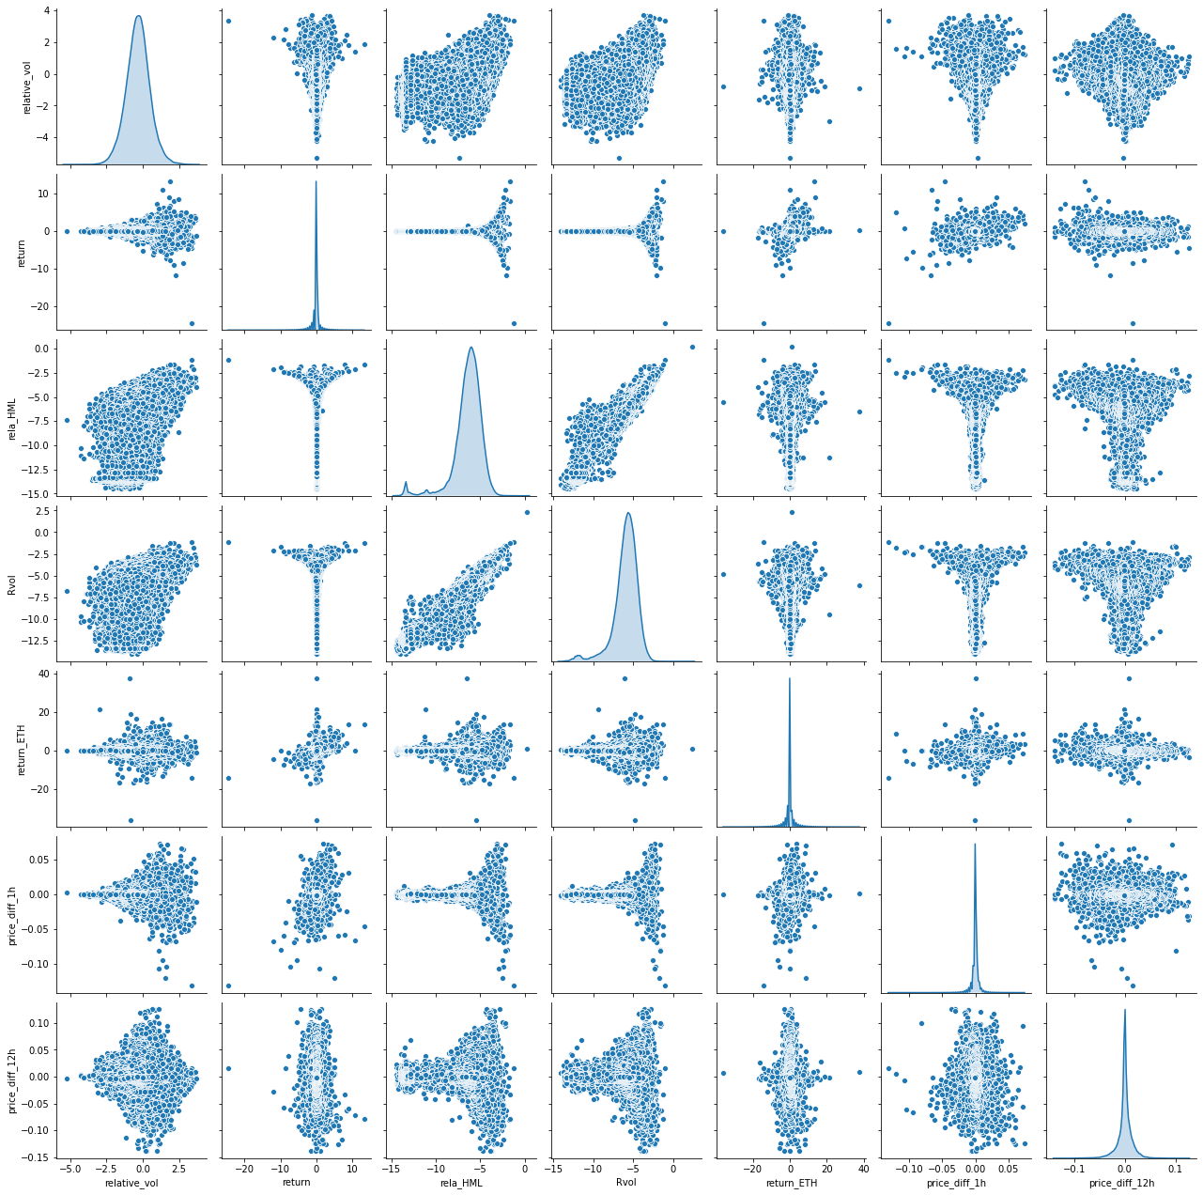
Feature Engineering

Slide 8
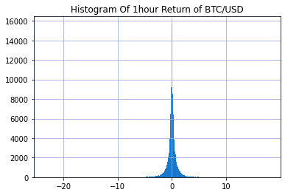
Feature Engineering
Distribution similar to the return/MACD features
Std: 0.9711% Min:-23.39% Max:17.9% (fatter tail than S&P500)

Slide 9
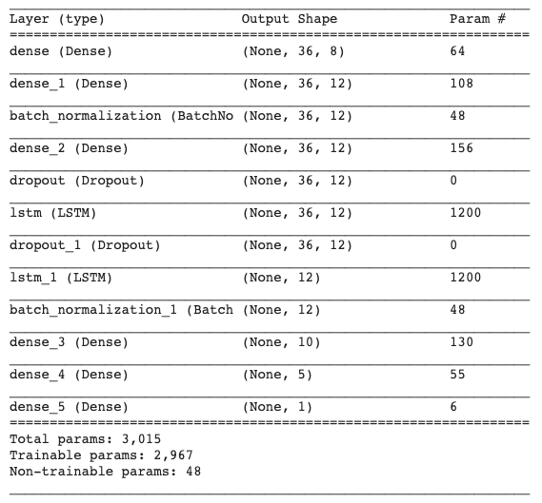
Training Model
3Dense + 2 LSTM + 3 Dense
NN Architecture

Slide 10
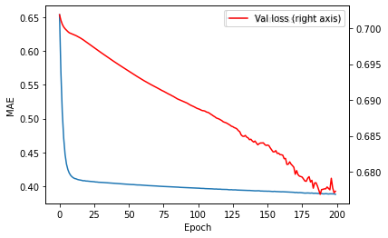
Training Model
Data: 2016-05-12 00:00 — 2017-07-12 00:00 （49455 data points）
Nadam ( α = 0.01)
Epochs: 200
Training Curve

Slide 11
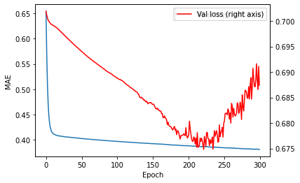
Training Model
Data: 2016-05-12 00:00 — 2017-07-12 00:00 （49455 data points）
Nadam ( α = 0.01)
Epochs: 200
Training Curve

Slide 12
Training Model On Rolling Horizon
Update the model every 90 days (Quarterly), and make prediction for the next 90 days
Training data set stays in a window of ~50K data points
Update the model with Earlystopping
Training Window | Prediction Window
2016-05-12 00:00—2017-07-12 00:00 | 2017-07-12 00:00—2017-10-09 23:50
2016-08-10 00:00—2017-10-10 00:00 | 2017-10-10 00:00—2018-01-07 23:50
2016-11-08 00:00—2018-01-08 00:00 | 2018-01-08 00:00—2018-04-07 23:50
2017-02-06 00:00—2018-04-08 00:00 | 2018-04-08 00:00—2018-07-06 23:50
2017-05-07 00:00—2018-07-07 00:00 | 2018-07-07 00:00—2018-10-04 23:50
2017-08-05 00:00—2018-10-05 00:00 | 2018-10-05 00:00—2019-01-07 21:50
Training & Test Sets

Slide 13
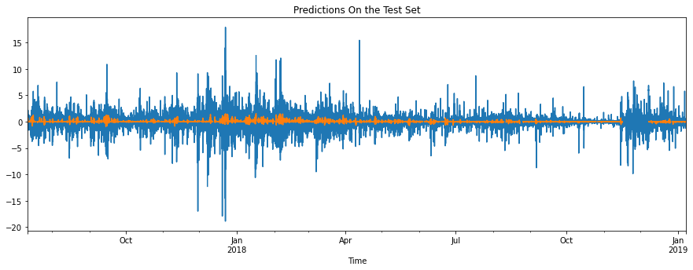
Model Evaluation
Predictions vs Realized 1-hour Return

Slide 14
Model Evaluation
 | Null Predictor | LSTM
MSE (%) | 1.18428 | 1.08169 | 8.7% less
MAE (%) | 0.64124 | 0.61579 | 4.0% less
Model Evaluation on Test Data (78469 data points)

Slide 15
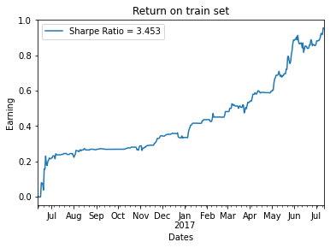
Model Evaluation — A Naïve Trading Model
Buy when prediction > 0.05%
Sell when prediction < -0.05%

Slide 16
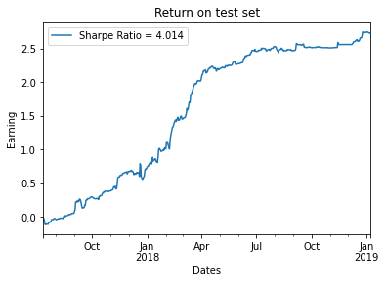
Model Evaluation — A Naïve Trading Model
Buy when prediction > 0.05%
Sell when prediction < -0.05%
Low risk of overfitting
Our predictions have some forecastability on BTC/USD returns

Slide 17
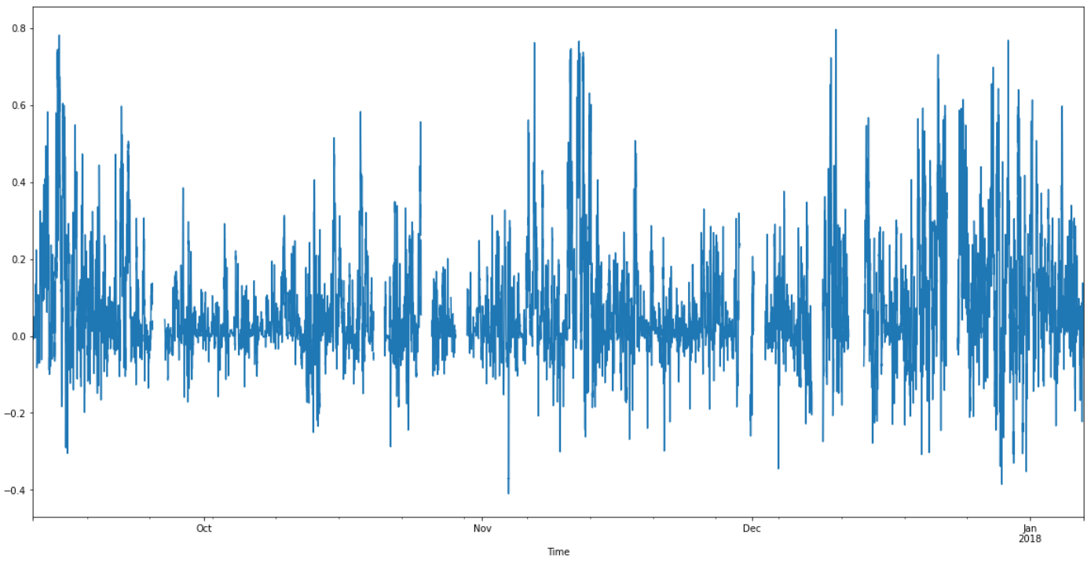
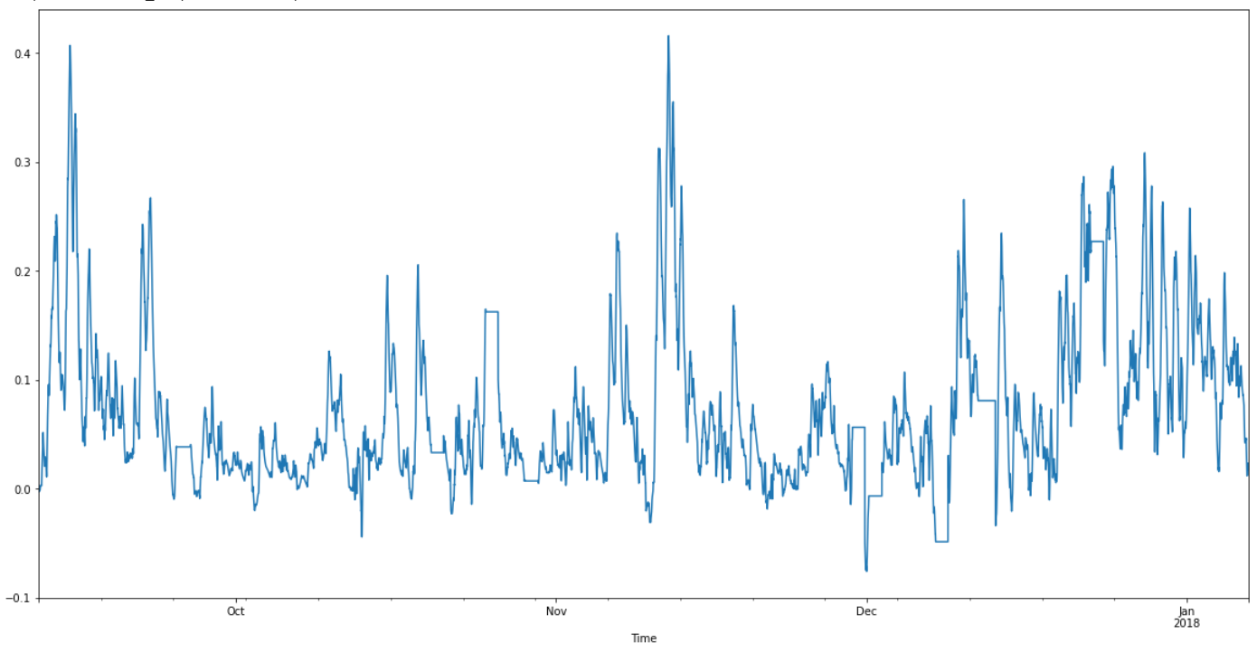
Trading Strategy
The trading strategy uses the signals from the model to trade on the BTC market.
Problem 1: Signal is too and jittery. Do not want to trade excessively on minor movements.
Solution: Use Exponential Moving Average of return signals to determine trade signals.
Raw Return Signal
EMA Return Signal

Slide 18
Trading Strategy
Problem 2: Do we trade on even the smaller positive (negative) signal? Might not be outside margin of error.
Solution: We only trade if the return signal is larger than some fraction of last day’s volatility. What fraction? Hyperparameter.
Problem 3: Might want to liquidate positions more/less aggressively than entering positions.
Solution: Different signal thresholds for entering and exiting positions.
Finally, to simulate real-life trading as accurately as possible, we include a 0.15% trading cost penalty to each transaction we make (both buy and sell components).

Slide 19
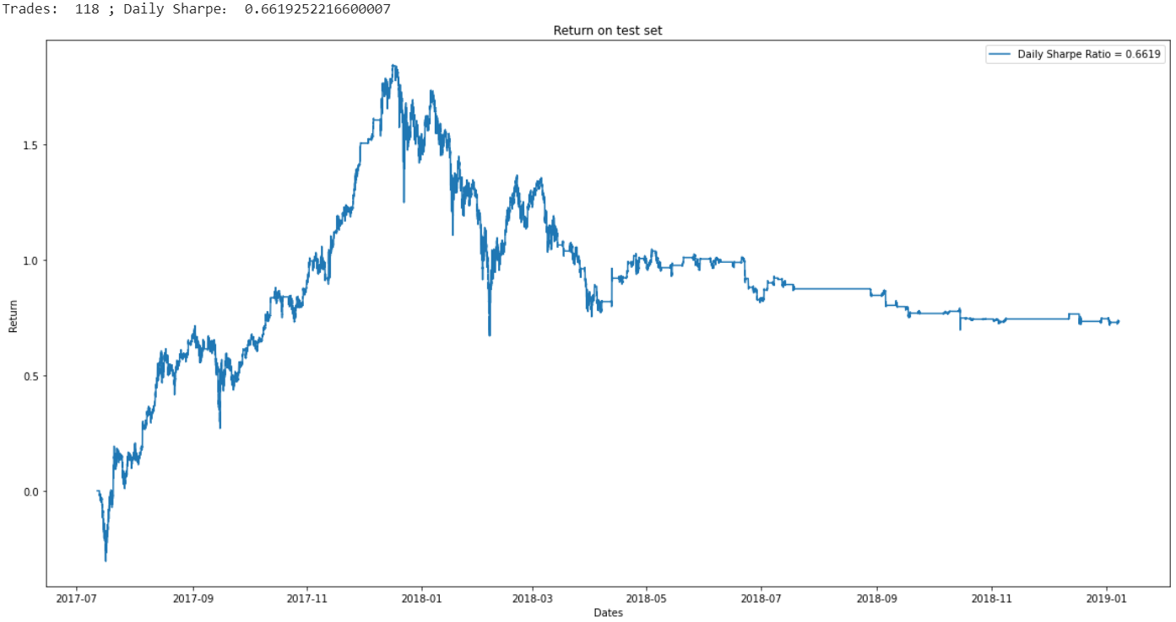
Results
For an initial run, we made an arbitrary choice of hyperparameters.
We open a long (short) position if the predicted positive (negative) return is more than 1 times the previous day’s volatility
We close a position if the predicted return is more (less) than 0.1 times the previous day’s volatility.

Slide 20
Results
We obtain a Sharpe ratio of 0.67 and a cumulative return of 73%. This is slightly better than BTC’s return of 50% over the same period. However, it comes at the cost of a slightly lower SR (0.67 vs 0.83).
This looks good but there is a catch!
Hyperparameter dependent! The hyperparameters here were arbitrarily chosen.
Ideal approach would be to tune hyperparameters on cross-validation set.

Slide 21
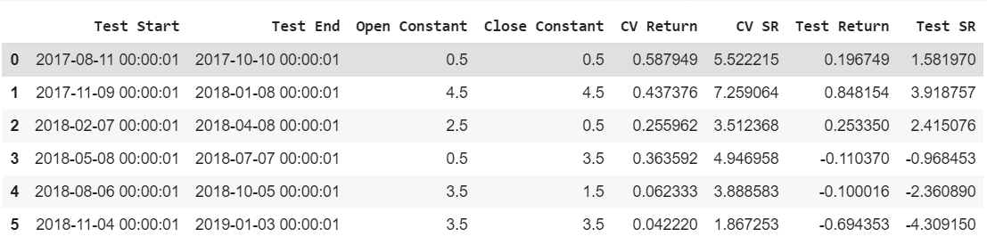
Results
After running a cross-validation approach, we found that the trading strategy is highly dependent on the chosen levels of trading aggressiveness (the open/close constants).
In addition to the explicit hyper parameters, there are several implicit ones. For example:
Length of Recalibration interval (30 days in above results)
Length of Retraining interval (90 days right now)
Finer grid of open/close constants

Slide 22
Further Refinements
Take into account bid ask spreads when computing returns.
Execution delay – In practice we may not be able to trade instantly on receiving signal.
Determine correct static rebalancing interval and hyperparameters – Need more computational power.
Better still – Model should recognize persistent underperformance on its own and signal the trading platform as such – Dynamic retraining intervals.

Slide 23
Thank you!
References
Sima Siami Namini, Akbar Siami Namin (2018) Forecasting Economics and Financial Time Series: ARIMA vs. LSTM. https://arxiv.org/abs/1803.06386
Bao W, Yue J, Rao Y (2017) A deep learning framework for financial time series using stacked autoencoders and long-short term memory. PLoS ONE 12(7): e0180944.
https://doi.org/10.1371/journal.pone.0180944
Aniruddha Dutta, Saket Kumar and Meheli Basu (2020) A Gated Recurrent Unit Approach to Bitcoin Price Prediction . Journal of risk and financial management. https://arxiv.org/abs/1912.11166

